Slide 1

PyTorch: Parallel Computing with CUDA
CS431 - Parallel Computation Course

Slide 2
Team
1- Mohamed Essam, 180114 (What is PyTorch and why using it)
2- Ola Abdallah, 180087 (Deep learning and neural network)
3- Nourhan Mahmoud, 180146 (GPU architecture)
4- Mohamed Abdelrahman, 180113 (CUDA and Parallel patterns)
5- Mohamed Gamal, 180104 (Data parallel code sample)

Slide 3
What is PyTorch?
PyTorch is an optimized tensor library for deep learning using GPUs and CPU
Used for fast, flexible experimentations
Developed by Facebook’s AI research lab
It leverages the power of GPUs

Slide 4
GPU-ready Tensor library
Tensors for GPU
Parallel computations at scale
Powerful, fast, NumPy-like functionality
Slicing
Indexing
Reductions
Linear algebra
Matrix and vector operations
Notes:
Tensor is a multidimensional array data structure that GPU understand it and perform operations on it.
Tensor is the central unit of data in PyTorch. It consists of a set of primitives values shaped into an array of any number of dimensions.
PyTorch tensors are device aware created on GPU which means you can perform parallel computations on these tensors at scale.
Which enable us to build huge complex neural networks
PyTorch tensors have been architected to make optimal use of GPUs for massively parallel computations

Slide 5

What is deep learning?
Limitations of traditional machine learning models to solve complex problems
Algorithms that learn what features matter by themselves
More data + more computations = better learning performance
Neural networks is the most common deep learning algorithms
Notes:
Traditional machine learning require experts to tell what features to pay attention while learning process

Slide 6
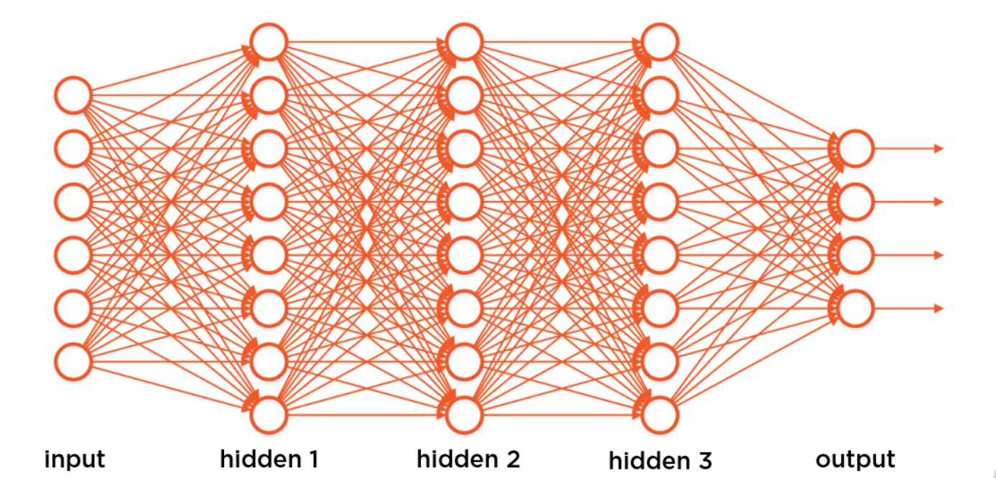
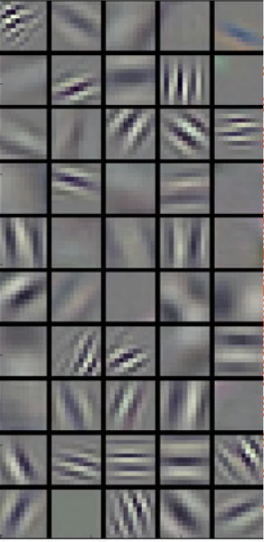
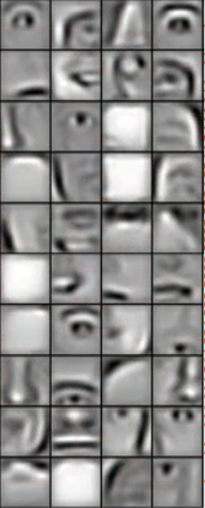
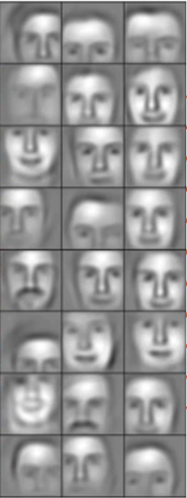
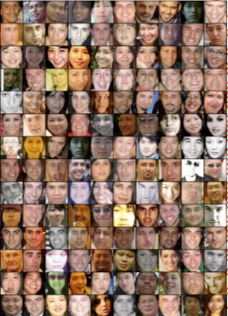
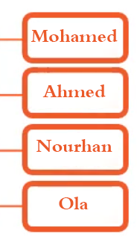
Neural network example

Slide 7
Why Parallel Computing For Neural Networks
- Typical structure of an ANN:
● For each training session:
○ For each training example in the session:
■ For each layer (forward and backward):
● For each neuron in the layer:
○ For all weights of the neuron:
■ For all bits of the weight value:
Notes:
ANNs aim to mimic the behavior of the human brain (processing approximately 10^16 operations/s while only dissipating a few watts)
in hopes of achieving similar performance. The brain's ability to interpret raw sensory data and perform behavior based on it outperform any modern design.
Training and evaluation of each node in large networks can take an incredibly long time
● However, neural networks are "embarrassingly parallel"
○ Computations for each node are generally independent of all other nodes
● The multiple layer structure of many feedforward networks and their backpropagation training technique severely limits the speedup of parallel neuron computations
○ Training set or network level parallelism more practical
● Neuron level parallelism more effective for single layer networks
○ SOM or some recurrent networks

Slide 8
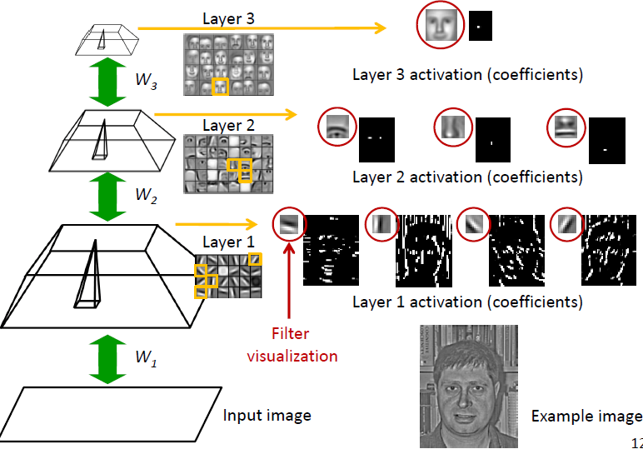
Neural network example (cont.)

Slide 9
PyTorch background
Relatively new than tensorflow
Initial release October 2016
Stable release April 2018
Based on Torch
Open-source ML library (since 2002)

Slide 10
Why PyTorch?
Open-source
Easy interface
Python-based scientific computing package
PyTorch platform offers dynamic computational graph. Thus user can change them during run time.
Notes:
Neural network can be redefined dynamically during the training phase for each epoch

Slide 11
Why PyTorch?
Multi-GPU processing
Distributed training
CUDA support
Makes it easier to test and develop new ideas.
Provide maximum flexibility and speed
Many algorithms and components are already implemented
Easier for debugging
Similar to NumPy and scikit-learn
Notes:
Neural network can be redefined dynamically during the training phase for each epoch

Slide 12
Installation
Via Anaconda
conda install pytorch
Via pip
pip install torch
Compatible versions with CUDA

Slide 13
GPU (Graphics processing unit)
Chips with highly parallel architecture
Video/graphics processing
Widely used in Big data and DL applications
Speed-up of 10-50 times with parallelism
Notes:
GPU: specialized chips with highly parallel architecture that makes them an order of magnitude faster than CPUs for some deep learning applications.

Slide 14
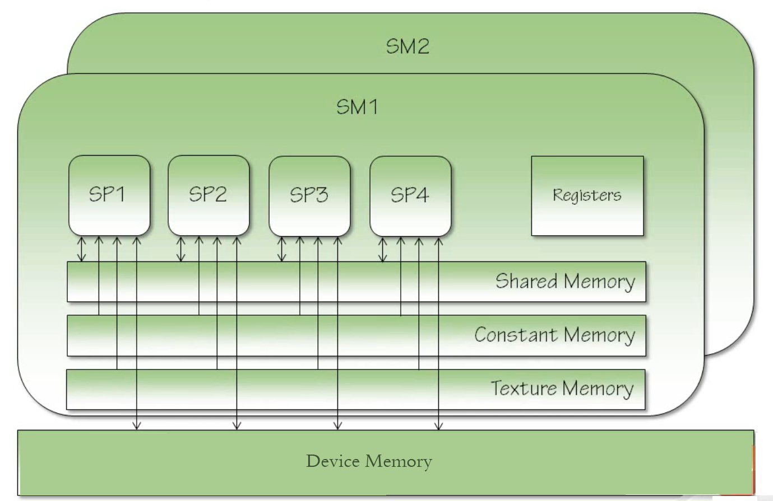
Graphics Processor Architecture
Streaming Multiprocessor (SM)
Streaming Processor (SP)
Notes:
CUDA Core also known streaming processor.
Device memory: global memory that available to all threads in all blocks in the grid, it take application lifetime, its slowest and most inefficient.
Constant memory: the memory that not change over kernel execution, just like lookup tables or fixed parameters that you need to pass into some model. It's also global and has application lifetime. So it's exist into device memory area but the area in SM is a cached from it.
Texture memory: like constant memory but optimized for 2D access patterns for game developers to doing some computation on graphics.
Shared memory: shared only with a thread block and not between blocks, it has kernel lifetime, also its very fast.
Registe: thread scope, kernel lifetime, very fast

Slide 15
CUDA
Parallel computing platform and API for Nvidia GPUs
General purpose usage (not only graphics)
GPU operations are asynchronous by default
Enqueued to particular device, execute later
Automatic synchronization between devices (CPU and GPU)
Notes:
If you want to support processing on GPUs, you must need to use CUDA CUDA is acronym for (Compute/common unified device architecture)

Slide 16
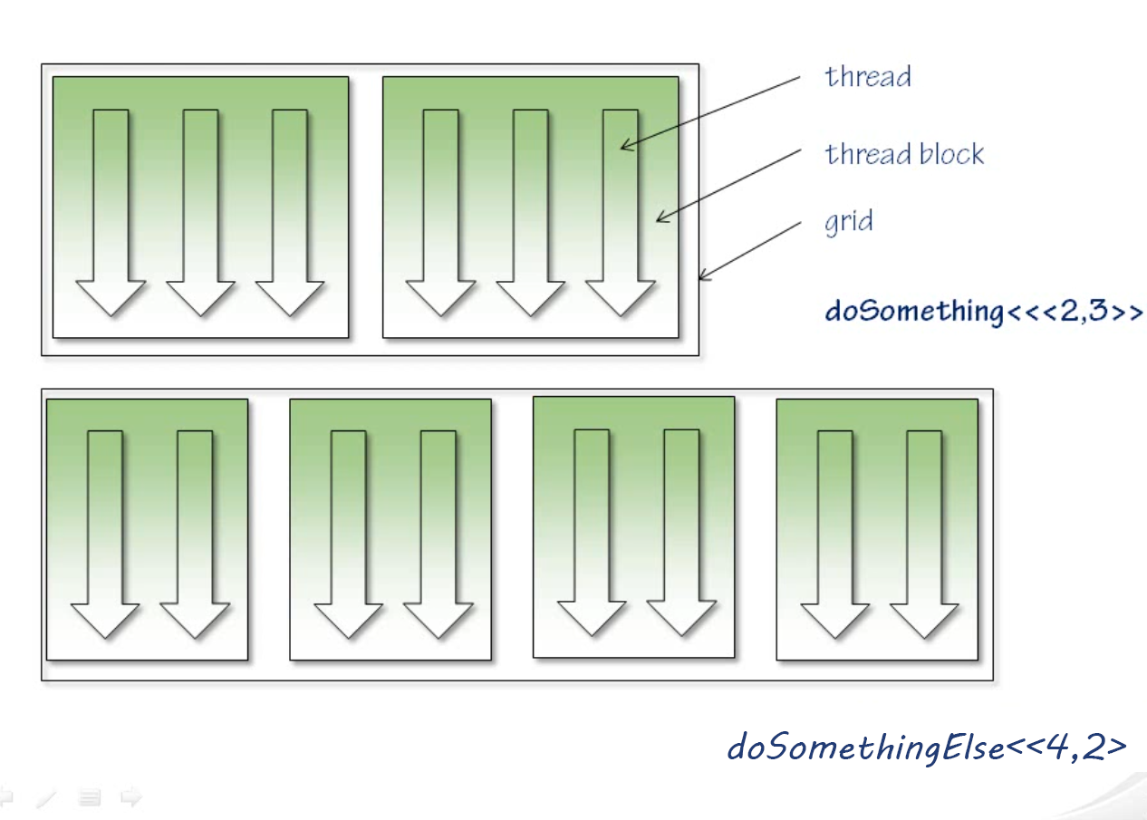
CUDA Execution Model
Each SM executes one block at a time

Slide 17
Parallel communications patterns
Map
Reduce
Gather
Scatter

Slide 18
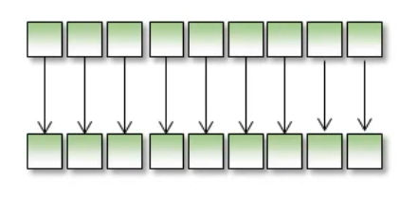
Map
Applying a function to an array and replicating that function ever every element in the array
No communications between threads

Slide 19
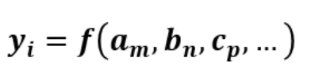
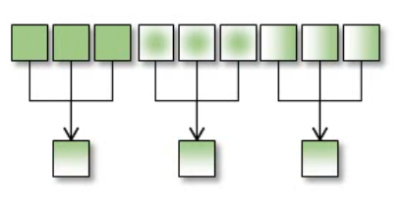
Gather
Applying a function to an arbitrary selection of input values to get an out value

Slide 20
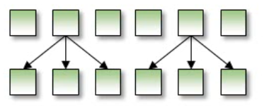
Scatter
Opposite of Gather
Notes:
Calculating several values from on value
Thread collisions when you have several threads writing to the same location

Slide 21
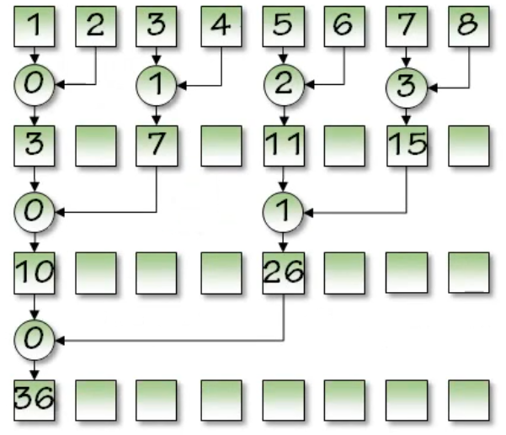
Reduce
Pairwise operation
- Parallel reduction:
- Adding up N data elements
- Use 1 block of N/2 threads
- Each thread does:
- x[i] += x[j]
- At each iteration
- # of threads halved
- Step size (j-i) doubled

Slide 22
4 Ways to Use Multiple GPUs With PyTorch
Data parallelism : datasets are broken into subsets which are processed in batches on different GPUs using the same model. The results are then combined and averaged in one version of the model.
This method relies on the DataParallel class.
Distributed data parallelism : enables you to perform data parallelism across GPUs and physical machines and can be combined with model parallelism.
This method relies on the DistributedDataParallel class.
Model parallelism : a single model is broken into segments with each segment run on different GPUs. The results from the segments are then combined to produce a completed model.
This method relies on the model_parallel class.
Elastic training : dynamically scale training resources for deep learning models, running PyTorch jobs on multiple GPUs and/or machines.

Slide 23
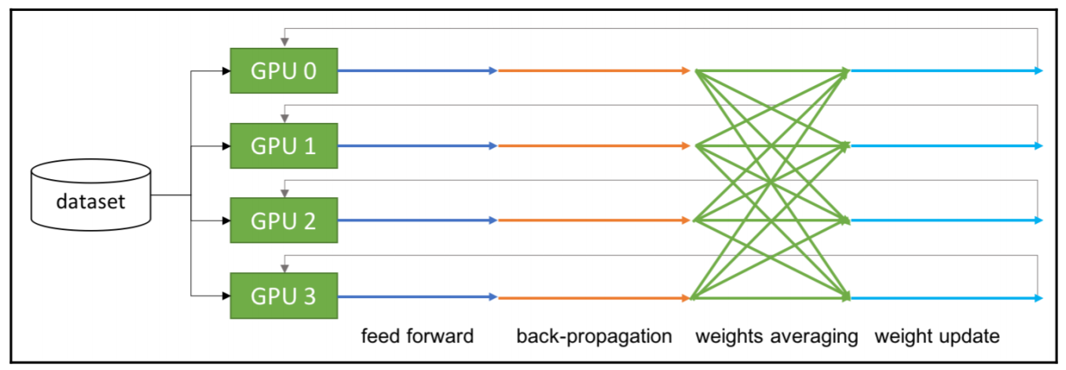
Data parallelism in PyTorch
Implemented using torch.nn.DataParallel
Each replica of the model handles a subset of data
Notes:
Replicate: replicate the model on multiple GPUs
Scatter: distribute the input in first dimension
Gather: gather and concatenate the input in the first dimension

Slide 24
Demo
https://colab.research.google.com/drive/13excn7blNGJR5Aq4sZVmlMR0wlXYs_y2?usp=sharing

